Slide 1
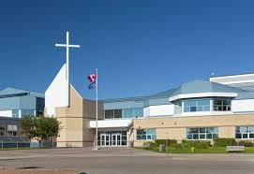
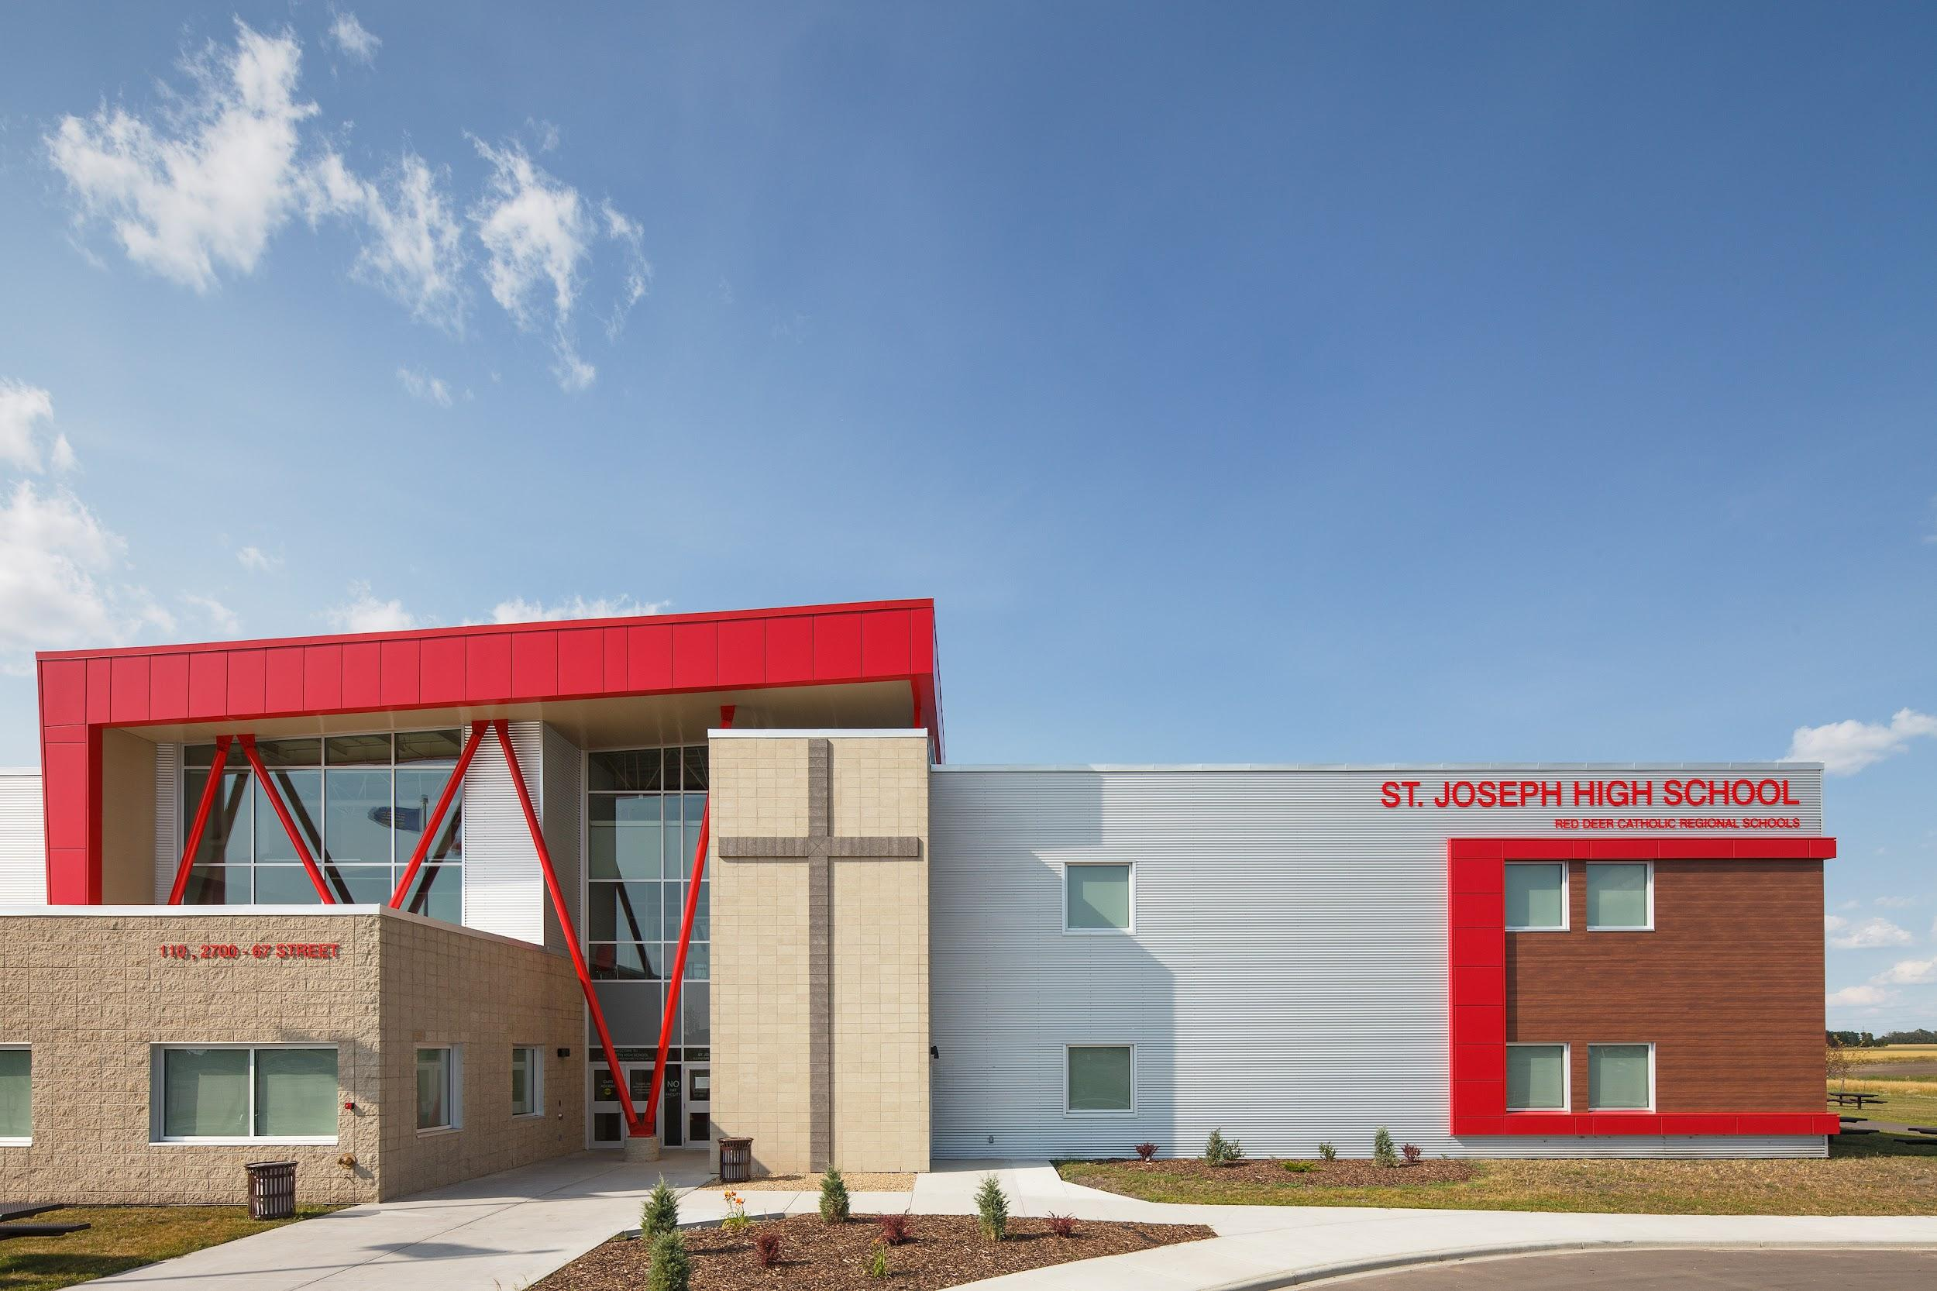
Welcome to your
Red Deer Catholic High Schools
Notre Dame High School
St. Joseph High School

Slide 2
High School Preparation
September - Information from MS Counsellors/Gr. 9 Teachers
Delivered Virtually - Try-a-Trade video (Notre Dame) Discovery Days (SJHS)
February 7-11 - HS Counsellors’ First Visits
February 25th (Notre Dame only)- High School 101- Virtual Presentation 7PM (For parents only)
March - Recommendations for Grade 10 classes Completed by Gr. 9 Teachers
March 7-11 - HS Counsellor’s Second Visit
March 8 SJHS - Grade 10 Open House @6:30pm
March 18 - Registration forms completed and returned
Notes:
ND

Slide 3
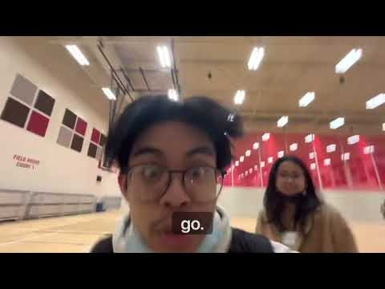
SJHS Co-Presidents’ Welcome
Notes:
St. Joes - 2:50

Slide 4
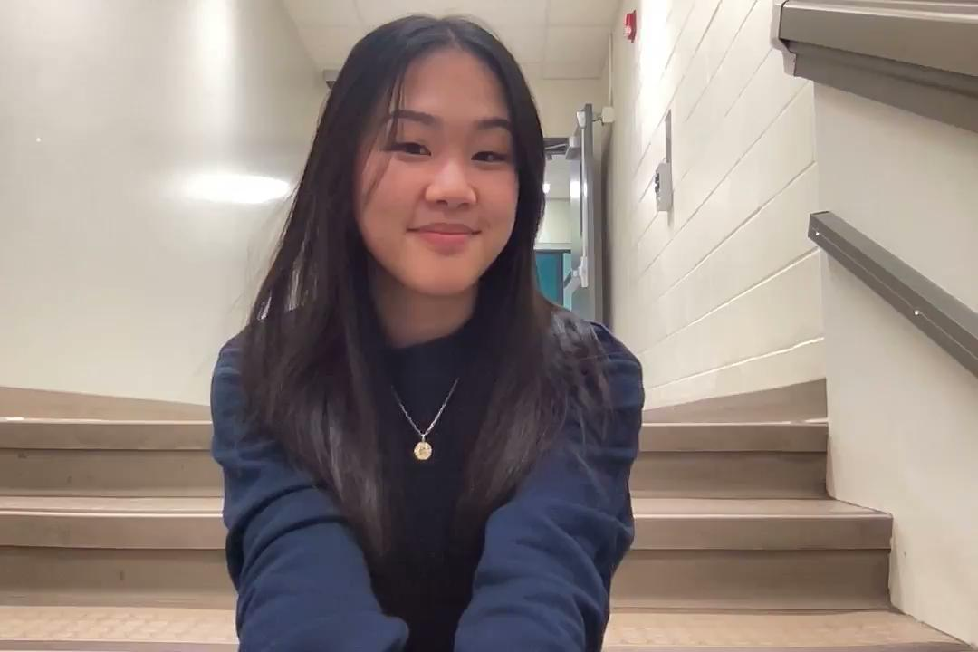
Hannah Ly
Notes:
ND

Slide 5
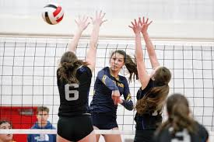
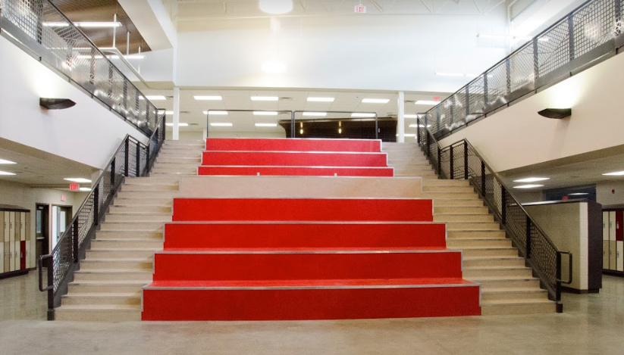
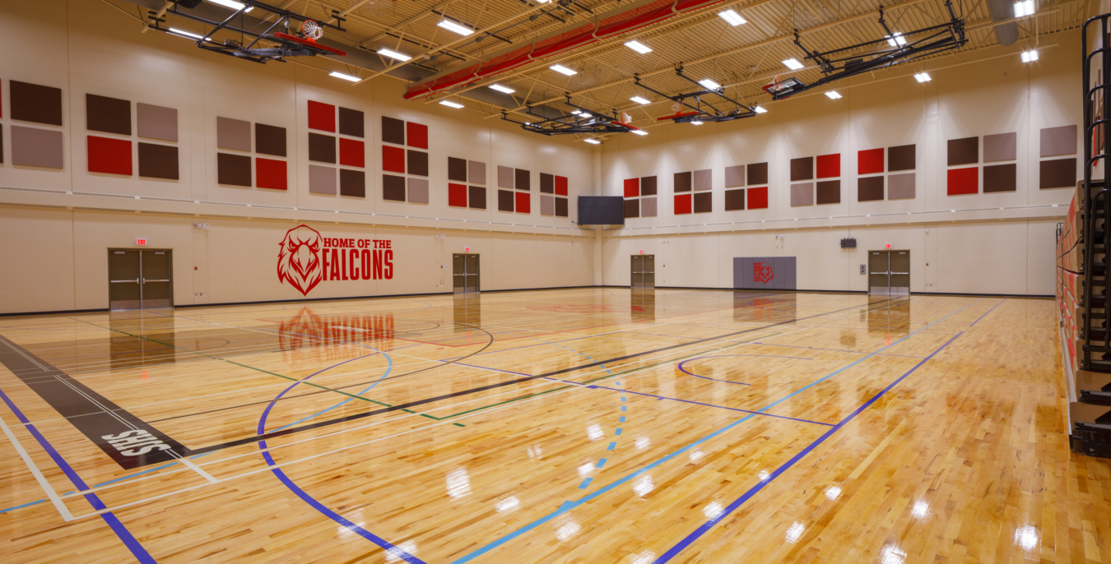
Notes:
Both

Slide 6
Notre Dame- approximately 1100 Cougars
St. Joe’s- approximately 775 Falcons
A great opportunity to meet students from different schools
A variety of exploratory classes that develop creative and technical skills.
Notes:
St. Joes

Slide 7
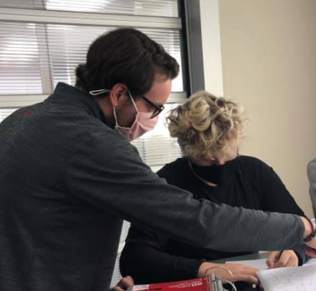
TAG & Scheduled Help
TAG
(Teacher Advisory Group)
Homeroom
Multi-graded
With this teacher for three High School years, so you really create a bond
Every Monday morning for 25 minutes
FLEX/Scheduled Help
Tuesday to Friday
Between Block 1 and 2
25 minutes for extra help with any staff
Notes:
St. Joes

Slide 8
NDHS & SSC
NDHS
(Notre Dame Help Session)
A 30 minute block after block 2
An opportunity to go to your teacher to get extra help.
Or, you can go to a different teacher of the same subject to get a different approach.
SSC
(Student Support Centre)
A resource to help students get caught up if they have missed school.
An opportunity for students to make up the time if they missed a class without being excused.
Notes:
Notre Dame

Slide 9
Day in the Life of a
SJHS Student
How many classes are there in a day?
For each student it may vary, but there are 4 blocks in a day, with 2 minute breaks in between. There are before and after school classes. (Band-Music Instrumental, Musical Production-Musical and Technical Theatre) Elite Athlete Sport Performance is during lunch.
4 Blocks? Wouldn’t that only be 4 hours of school?
Each block is about 1 hour and 20 minutes, with some variation depending on each day’s schedule.
8:42 am | Prayer
Approx 80min | Block 1
25 minutes | Scheduled Help
Approx 80min | Block 2
60 minutes | Lunch
Approx 80min | Block 3
Approx 80min | Block 4
3:32 pm | Blessing
Notes:
St. Joe’s

Slide 10
A Day in the Life of a
NDHS Student
How many classes are there in a day?
For each student it may vary, but there are 4 blocks in a day, with 2 minute breaks in between, that can be filled with a class. There are before and after school classes as well. (Sport performance, Fit4Life, Band, Production, and Technical Theatre)
4 Blocks? Wouldn’t that only be 4 hours of school?
Each block is about 1 hour and 20 minutes, with some variation depending on each day’s schedule.
8:48 am | Prayer
Approx 80min | Block 1
Approx 80min | Block 2
30 minutes | NDHS
Approx 45 min | Lunch
Approx 80min | Block 3
Approx 80min | Block 4
3:30 pm | Blessing
Notes:
Notre Dame

Slide 11
Attendance
We are an attendance based school and have an attendance policy.
Celebrations and period 5’s are instructional minutes and are mandatory.
If you miss school please ensure that your parents call the attendance line and excuse the absence.
Student Lates
What are the natural consequences of missing a class?
Notes:
ND

Slide 12
Cell Phones
Here is what you need to know!
Mobile phones/smartwatches should be “off and away” during all class times in learning communities.
If you have your cell phone in an instructional space, you will take it to the main office yourself where it will be kept in a locked locker until the end of the school day. If this occurs three times, your parent is required to pick up your cell phone
You are able to use your cell phone prior to school, during lunch, during breaks and after school.
Notes:
St. Joes

Slide 13
Food & Transit
Food
Vending Machines
The cafeteria is open every school day and accepts debit.
A vast menu offers healthy breakfast and lunch options and a variety of snacks and drinks.
Both schools have an open campus so you can leave for lunch as well…. Lots of choices nearby! Don’t be late for class!!
Transit
Parking passes are $20 (ND) and $10 (SJHS) for the year... Parking tickets are $90. Register your vehicle at the office and avoid hefty fines.
Bus passes are issued based on home address. Restricted passes are free, while unrestricted passes cost $8/month (for those that live further than 2.4km away) and must be paid for in advance.
Notes:
ND

Slide 14
Exploratory Courses
Modern Languages
French, Japanese
Trades, Manufacturing & Transportation Courses
Robotics, Welding and Metal Design
Media, Design, and Communication Arts
Visual Communications, Computer Science, Design Studies
Health, Recreation, Human Services
Foods, Medical Studies, Sports Medicine, Cosmetology, Esthetics, Psychology, Leadership, Wildlife and Outdoor Ed., Elite Athlete, Health, Wellness & Recreation
Fine Arts
Drama, Technical Theatre, Musical Theatre, Dance, Instrumental Music, Guitar, Art
Notes:
St. Joes - Twila

Slide 15
Exploratory Courses
Modern Languages
Spanish, French
Trades, Manufacturing & Transportation Courses
Mechanics, Cosmetology, Robotics
Media, Design, and Communication Arts
Visual Communications, Photography & Digital Imaging, Graphic Design, Computer Science,
Health, Recreation, Human Services
Foods, Medical Studies, Sports Medicine, Cosmetology, Esthetics, Psychology, Leadership, Wildlife and Outdoor Education
Fine Arts
Drama, Technical Theatre, Advanced Acting, Musical Theatre, Dance, Instrumental Music, Art,
Notes:
ND

Slide 16
Athletics
Football
Golf
Cross Country Running
Volleyball
Basketball
Curling
Wrestling
Rugby
Badminton
Soccer
Team Handball
Track & Field
Tennis
Notes:
St. Joes

Slide 17
Notre Dame Hockey Academy
Are you looking to improve your hockey skills?
Do you want to improve your stickhandling, add m.p.h to your slapshot, and skate more efficiently?
Are you hoping to get a college scholarship, but need a little help to maximize your athletic potential?
The Notre Dame Hockey Academy will help you achieve these goals so you can make the team next season. Our academy offers students an opportunity to participate in a high school course that is more specific than a regular Physical Education class. We’re looking for novice to elite level student athletes to come join us!
Notes:
ND

Slide 18
SJHS Ball Academy
The St. Joseph Baseball/Softball Academy will help you achieve these goals so you can make the team next season. Our academy offers students an opportunity to participate in a high school course that is more specific than a regular Physical Education class. We’re looking for novice to elite level student athletes to come join us!
OPEN HOUSE: MARCH 7, 2022 @6:30PM AT SJHS
Are you looking to improve your baseball or softball skills?
Do you want to increase power in your swing, add m.p.h to your fastball and get to that ground ball in the hole?
Are you hoping to get a college scholarship, but need a little help to maximize your athletic potential?
Notes:
St. Joes

Slide 19
How to Get Involved!
Yearbook
Theater (Singing, Dancing, Acting, Stage Crew, Lighting, Set Design, etc.)
Band
Sports (Football, Golf, Cross Country Running, Volleyball, Basketball, Curling, Wrestling, Rugby, Badminton, Soccer, Team Handball, Track & Field, Tennis)
GSA Club
Youth Ministries
Leadership
Student Council
Grad Committee
Writing Club
Chess Club
Dungeons and Dragons Club
International Travel
Robotics Club
Ski Club
League of Legends Game Club
Notes:
ND

Slide 20
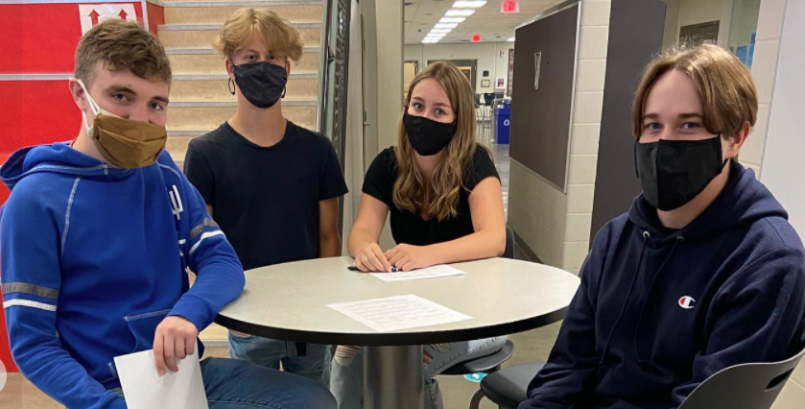
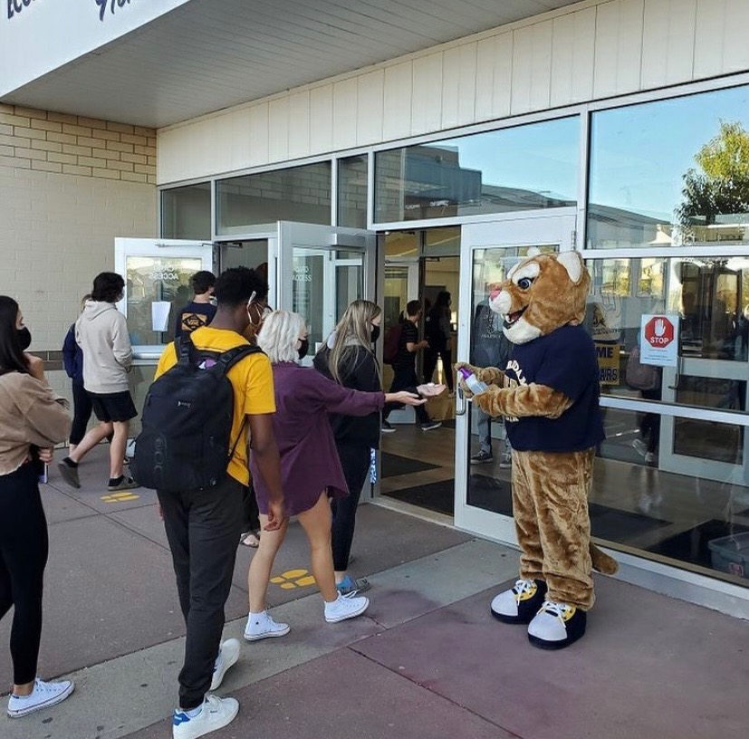
Grade 10 Day
First Day in school with only Grade 10 students
Allows students to get acquainted with High School
Notes:
St. Joes

Slide 21
Why is High School
Awesome!!!?
Sports
Opportunities
School Spirit
Clubs
Finding yourself!
Open Campus
Friends
Service Projects
Graduation
Travel
Notes:
ND

Slide 22
Notes:
Length - 7:03

Slide 23
SJHS
Notes:
Length - 3:39

Slide 24
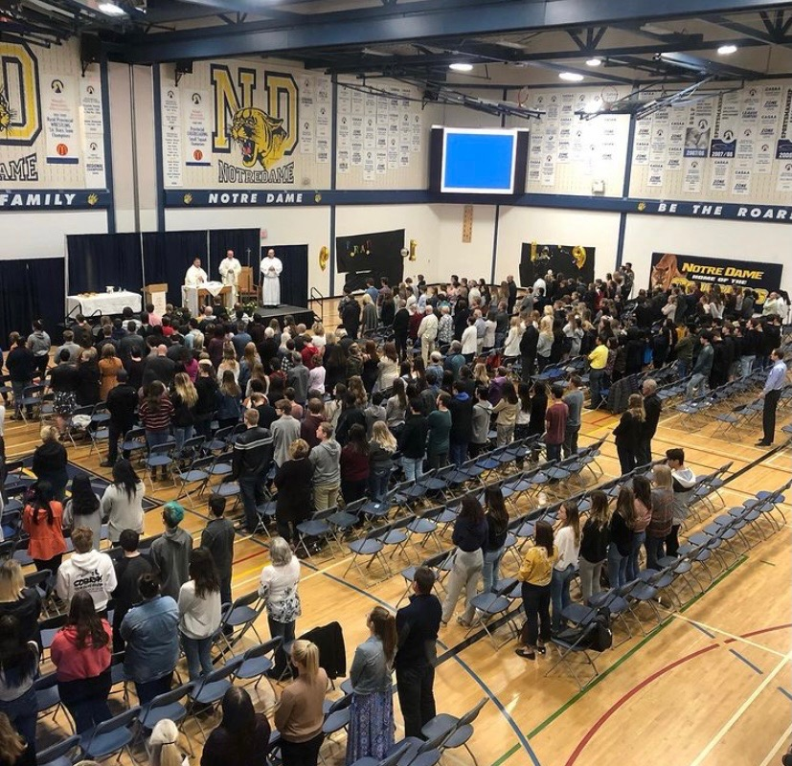
QUESTIONS?
This presentation will be posted on each school website.

